Slide 1
Fluid Flow in Pipes
Group 3
Hussein Rezk
Adil Feratovic
Anna Cai
Aaron Casas
Chemical Engineering Lab I
Date

Slide 2
Introduction
Analysis of Flow Systems is an important part of Chemical Engineering
It is necessary to calculate the pressure drop to select a pump for a desired flow
Most chemical processes involve fluid flow in a pipe in order for materials to be transferred to reactors, separators, storage facilities, etc.
The purpose of this lab is to conduct various experiments to calculate energy loss coefficients such as,
Friction Factor, f
Loss Coefficient, K
Flow Coefficient, Cf
In order to test available theories and correlations in the study of Fluid Flow and Transport Phenomena

Slide 3
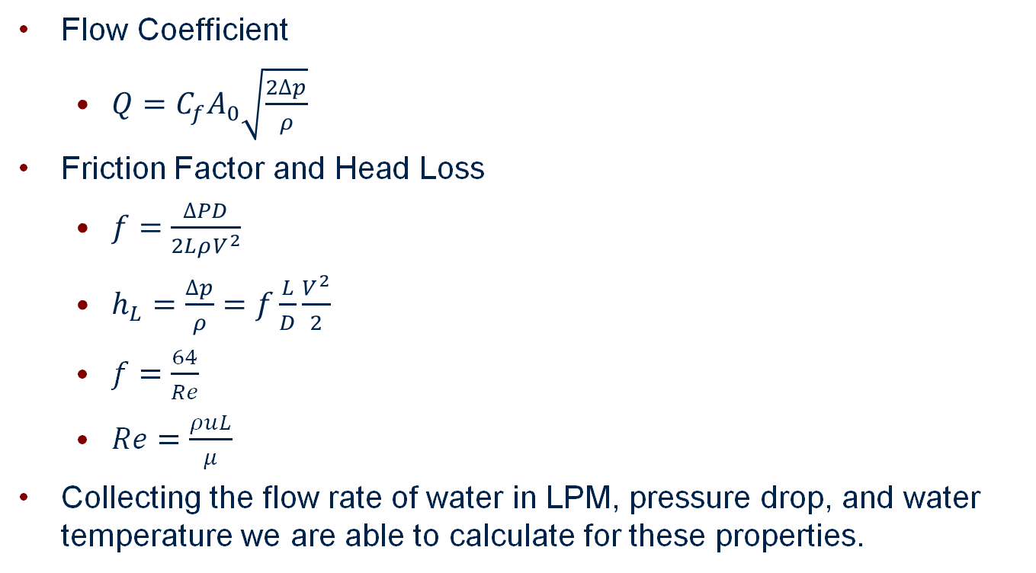
Theory
Flow Coefficient
$Q=C_{f}A_{0}\sqrt{\frac{2∆p}{ρ}}$
Friction Factor and Head Loss
$f=\frac{∆PD}{2LρV^{2}}$
$h_{L}=\frac{∆p}{ρ}=f\frac{L}{D}\frac{V^{2}}{2}$
$f=\frac{64}{Re}$
$Re=\frac{ρuL}{μ}$
Collecting the flow rate of water in LPM, pressure drop, and water temperature we are able to calculate for these properties.

Slide 4
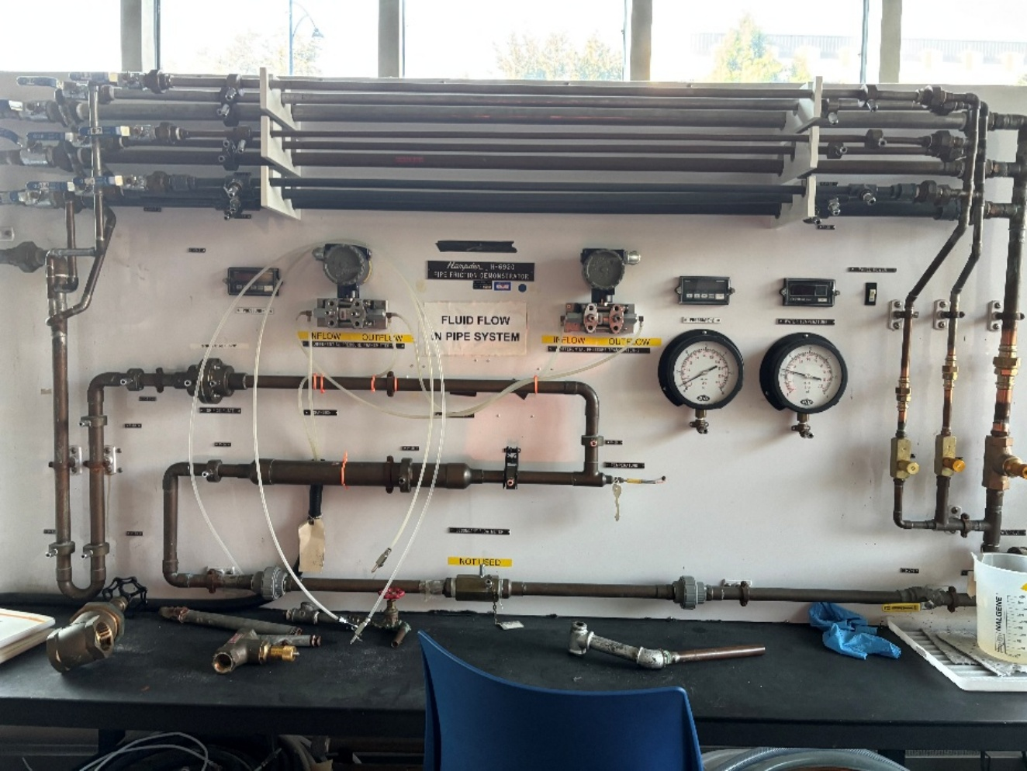
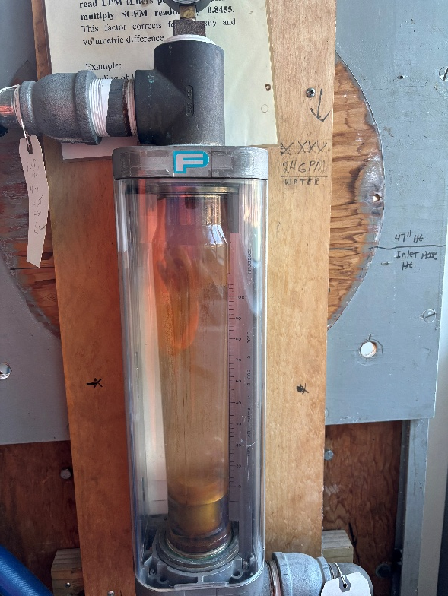
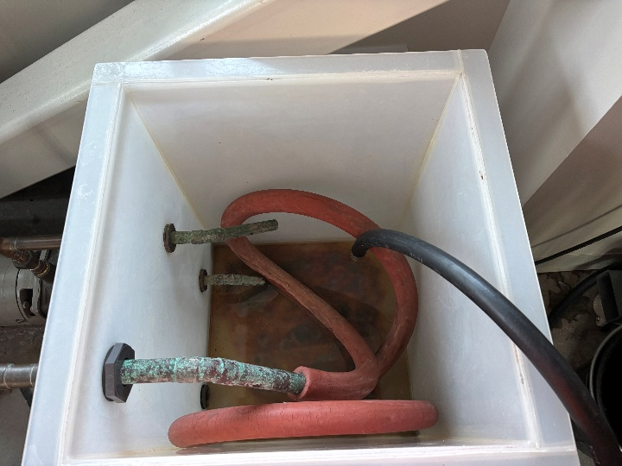
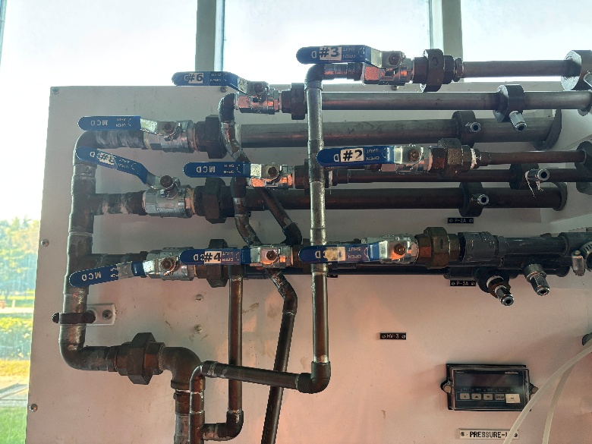
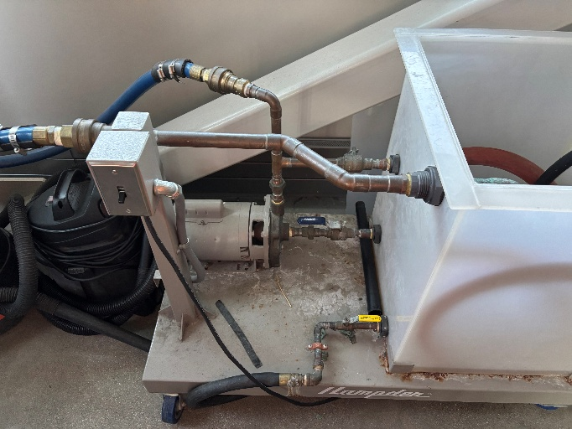
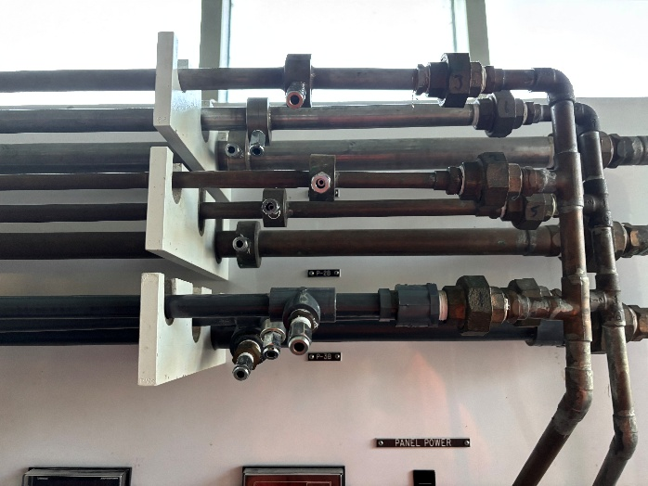
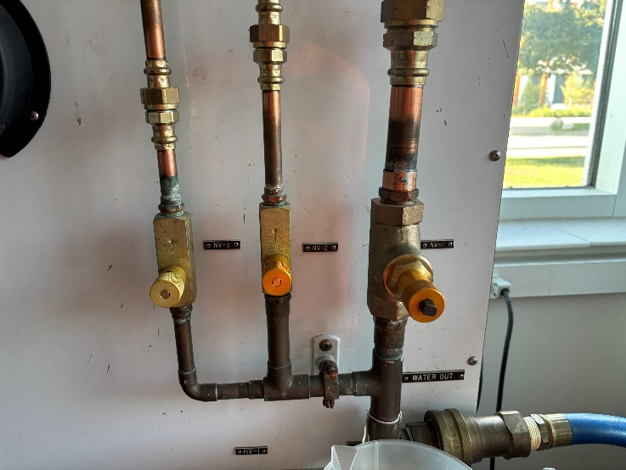
Apparatus

Slide 5
Material & Supplies
Caliper
Tape Measure
Pump
Water
Flow meter
Volumetric Cylinders
Volumetric Bucket
Purge Streams Tubes

Slide 6
Procedure
Rotameter Calibration: Measure SCFM and LPM. Graph it. Slope is conversion
Orifice: Connect DPT across orifice taps using tubes. Take 8-10 flow setpoints and record Q, P, and T
Friction Head Loss: S/M/L 3 materials and 8-10 points. Connect tubes up/downstream taps for pipe section. Measure P, Q, and T
Fitting Head Loss: For different fittings, connect DPT and measure P, Q, and T for 6-8 points

Slide 7
Experimental Challenges
Purge every time
When pump is running and water is flowing through the system, make sure at least 1 valve is open
Wait for temperature to stop fluctuating

Slide 8
Safety
Make sure safety glasses are worn when conducting the experiments
Water can leak, make sure to allow it to fall into a bucket and not make a mess
Make sure water is filled in tank to allow the pump to not run dry
Make sure streams are purged when conducting flow

